Slide 1
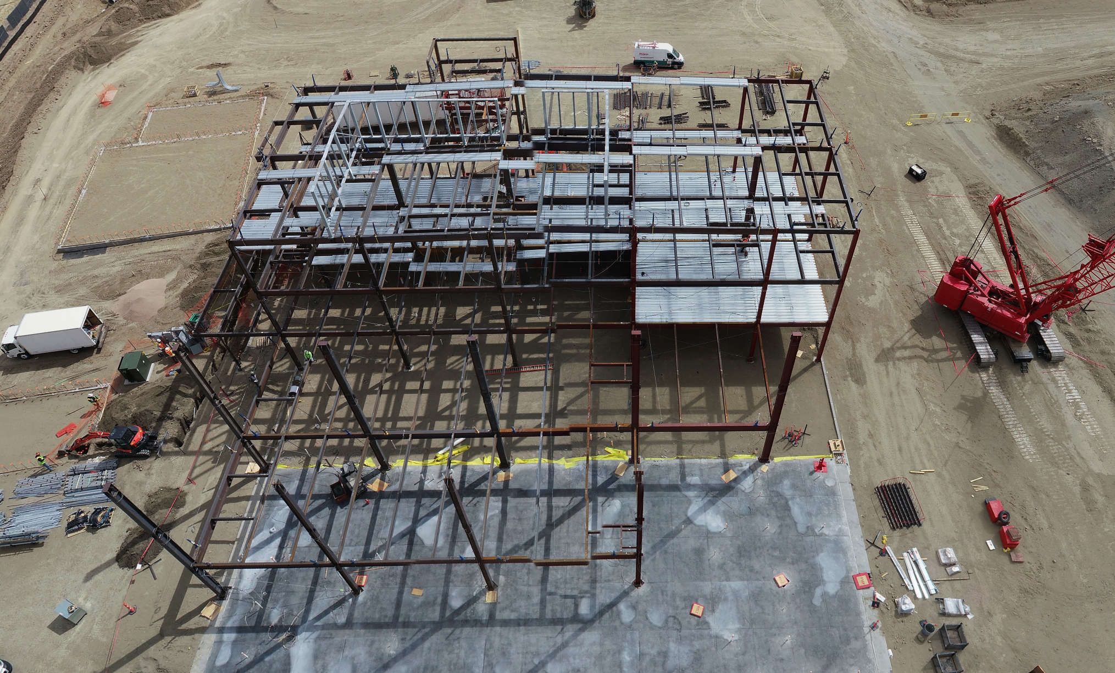

Project 3 PRESENTATION
Group 4
Aaron Albers
Jackie Schuler
Jon Haas
Structural Steel Fabrication DB
University of Kansas – Data Analytics Boot Camp

Slide 2
Project Description & Motivation: Why?
Analysis of Data Output from Estimating Software:
For businesses which rely on winning bids to secure projects, analyzing estimating data from past and current projects can:
Improve win percentages on future bids
Significantly improve the accuracy of estimates
Improve Profitabality
Target jobs which best fit production schedules

Slide 3
Top 3 Datasets Being Pursued
1. Common Estimate Tables: These tables are common to all estimates.
Shapes: The shapes data base defines the material shape. I.E. Angle, Channel, Beam, Pipe, Tubing, etc.
Sizes: The Shapes data defines the size of each shape. I.E. An Angle Could be a 4x4x1/4, meaning each leg of the angle is 4” wide and ¼” thick.
Grade: The Grade data base contains the types of grades for all material shapes and sizes used within the estimate. I.E. strength, ductility, chemical makeup, etc.

Slide 4
Top 3 Datasets Being Pursued (continued)
Laborgroups: The laborgroups data defined the types of labor: I.E. Material handling, Sawing, Drilling, Welding, Painting, etc.
Laborrates: The Laborrates data defines the cost for each labor group. I.E. Sawing $125/hr, Welding $80/hr, Painting $75/hr, etc.

Slide 5
Top 3 Datasets Being Pursued (continued)
2. Manual Estimate Tables: These tables are generated from each individual manual estimate. A manual estimate is typically completed by an estimator based off of customer supplied drawings.
Estimateitems: Defines the particular material selected for each part in the estimate. I.E. A job has a Column, the column is to be made out of a material shape, size, and grade at a specified length.
EstimateItemlaborgroups: Each Estimateitem has labor hours applied to it from each labor group. I.E. The column above has .5 hours of sawing applied, 1 hour of welding applied, and .75 hours of painting applied, etc.
Estimate: The estimate data provides information identifying the estimate such as jobname, estimate #, customer, etc.. The estimate data also provides a summary of all of the estimate items, including material weight, number of pieces, and summary of total labor hours and cost.

Slide 6
Top 3 Datasets Being Pursued (continued)
Estimodel Tables: These tables are generated from each individually detailed and engineered computer model of won projects.
An Estimodel is typically generated for awarded jobs based off of production models.
The Estimodel is automatically generated based off of the same parameters setup in the Manual Estimate. However,:
The Estimodel is generated automatically by computer.
The Estimodel is usually much more accurate.
Does not conservatively over estimate
Does not miss or overlook items.
Identifies part numbers for each unique item which can be aligned with production part numbers.
Can be used by Purchasing for very accurate nesting and procurement of materials in exact shapes, sizes, grades and lengths required for production.
Can be used to generate accurate sequential production schedules.

Slide 7
Top 3 Datasets Being Pursued (continued)
The tables used for the Estimodel are believed to be the exact tables used for the manual estimates, however we have not verified.
From examination of the Estimodel data, it is apparent much more data is generated by the Estimodel.
Very important production information is identified:
Main part numbers – identify each part to be shipped to jobsite
Small part numbers – small parts attached to main parts.
For this project, we did not examine the Estimodel data:
We believe Data Engineering should follow fundelmental sound engineering practices.

Slide 8
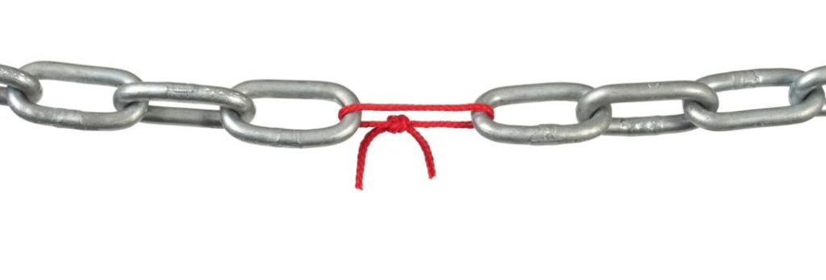
FOCUS ON THE WEAKEST LINK

Slide 9
Why is the Manual Estimate data worth exploring?
Before we can improve the Manual Estimate process, we must be able to accurately validate it.
Currently, the only way we have to systematically validate the manual estimating process is to wait until each job is complete. Once a job is complete, accounting summarizes all of the materials and labor and compares it against the estimate summaries at a macro level. Why is this a problem:
Timeframe: The time it takes to complete a large job maybe several years.
We and only see totals:
Total material for each material group
Total labor for each labor group
Manual Estimates do not have part numbers:
We have no way to systematically compare manual estimates to estimodel and ultimately to production at a part level.

Slide 10
Hypothesis / Solution:
Thru data analysis we can systematically identify relationships between the material and labor take-offs in the Manual Estimate and associate them with part numbers within the Estimodel and production.
The Project was a huge success in completing the first step in HME’s Continuous Improvement Process to systematically validate the accuracy of the Manual Estimating Process a production part level.

Slide 11
ESTIATING
KEYS TO CONTINUED SUCCESS MOVING FORWARD WITH THE NEXT PHASE OF THIS PROJECT

Slide 12

BE WILLING TO EBB AND FLOW
WITH THE INFORMATION THE DATA GIVES US

Slide 13

CONTINUOUS IMPROVEMENT IS KEY

Slide 14
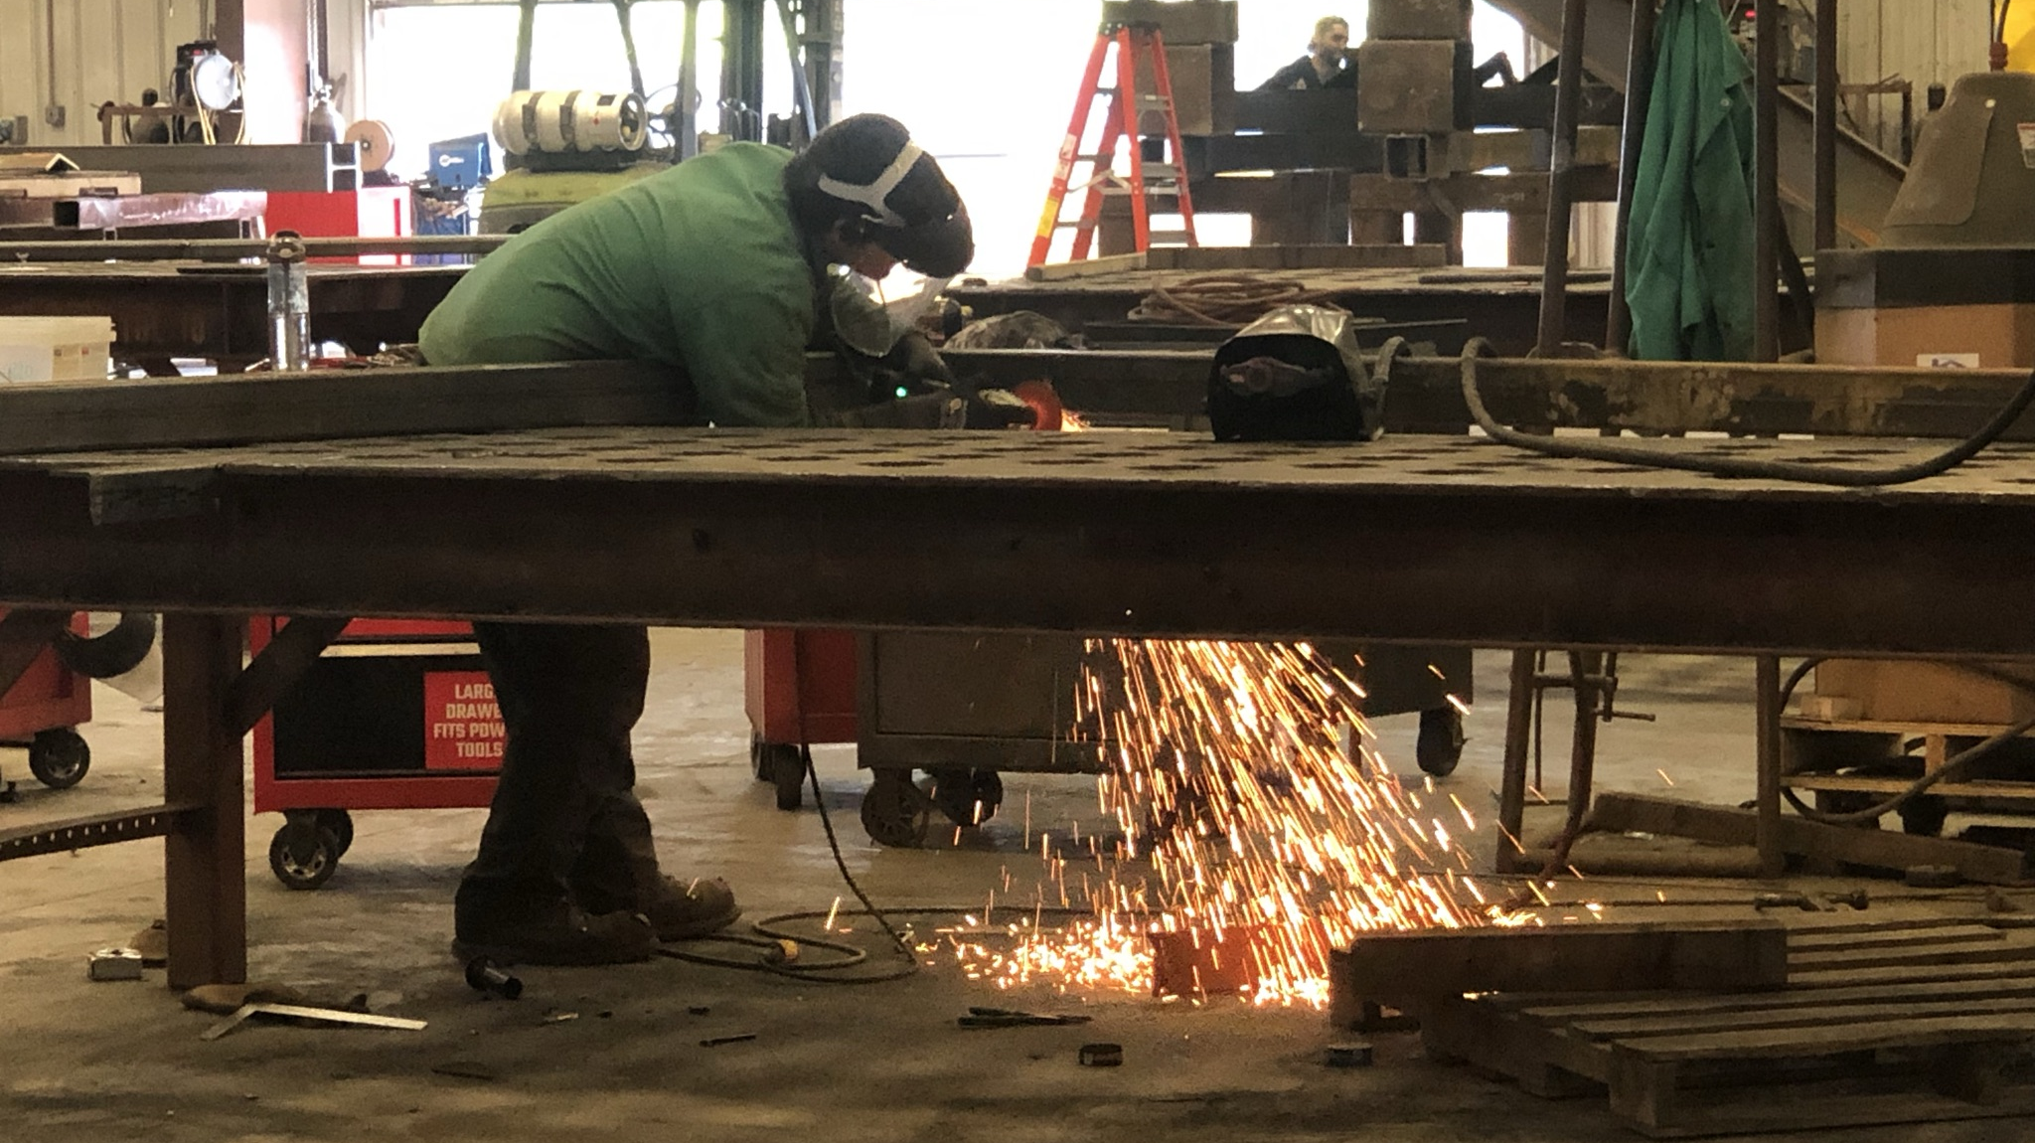
Thank you.
BE > YESTERDAY

